Slide 1

Digital Prescription Report Analysis
Presented by:
Kalaivani

Slide 2
Agenda
Project Overview
Project Workflow
Project Scope
Data Visualization
Dataset Overview
Key findings & Result

Slide 3
Problem Statement
Healthcare organizations generate large volumes of prescription data, making manual analysis difficult and time-consuming. This project provides an automated solution to analyze prescription records, visualize trends, and generate actionable healthcare insights efficiently.
Project Overview
Digital Prescription Record Analysis is a healthcare data analytics project that analyzes prescription records to identify trends, patterns, and insights. Using Python, MySQL, and data visualization, the system transforms raw healthcare data into meaningful reports for better decision-making.

Slide 4
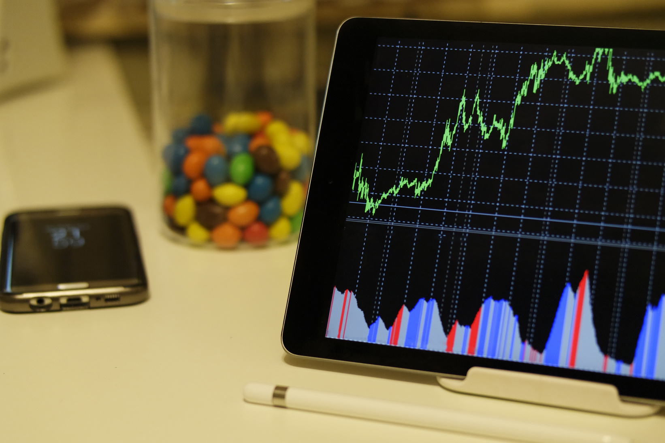
Project Scope
Analyze patient and prescription data.
Study doctor specialty and experience trends.
Create visual reports and charts.
Store and manage records using MySQL.
Provide insights for healthcare improvement.

Slide 5
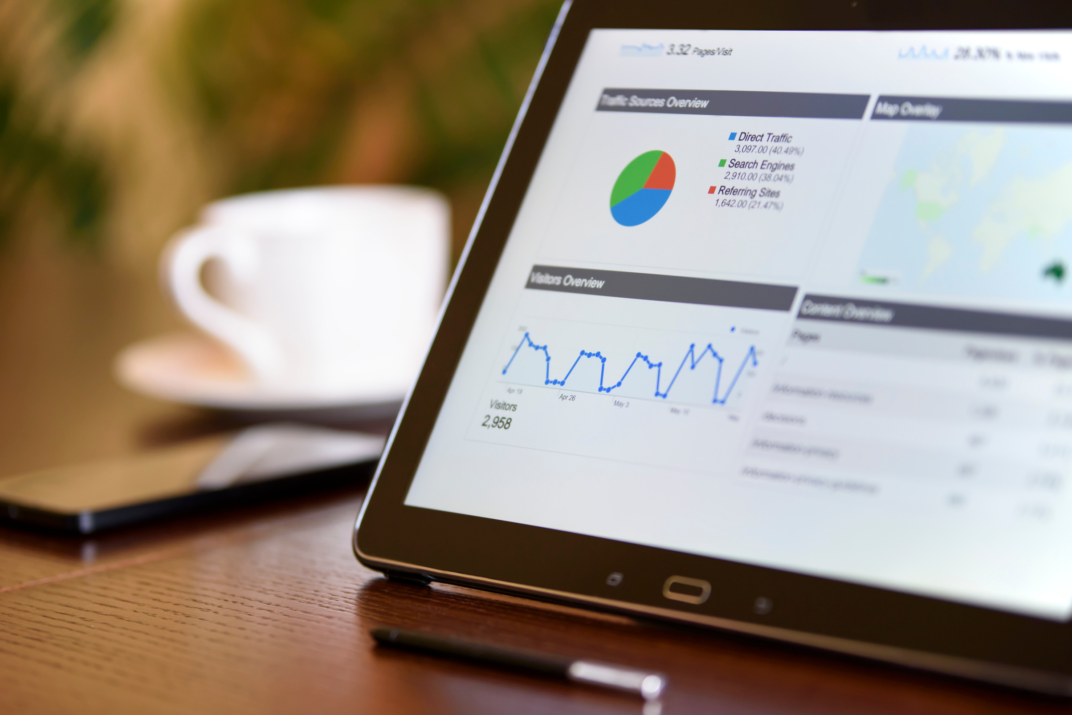
Data Overview
Total Records
Reporting Period
Data Sources
Key Categories
Digital Prescription System, Hospital Records, Doctor Consultation Logs, Pharmacy Data
Patient Info, Doctor Details, Prescription Data, Medicine Usage, Diagnosis Details
2020 - 2026
20,000+

Slide 6
Project Workflow
Data Collection
Data Integration
Data Acquisition
Data preprocessing
User Interface Development
Data Visualization
Data Analysis using Python
Database Management

Slide 7

Project Explanation
This project analyzes healthcare prescription data to extract useful insights about patients, doctors, diseases, and medicines. Raw CSV data is cleaned using Pandas and stored in a MySQL database for structured management.
Python is used to perform data analysis and generate meaningful insights through visualization techniques like charts and graphs. The system helps identify prescription trends, doctor specialization patterns, and patient visit behavior.
Finally, a CLI-based interface is developed to allow easy interaction with the analysis system and view results efficiently.

Slide 8
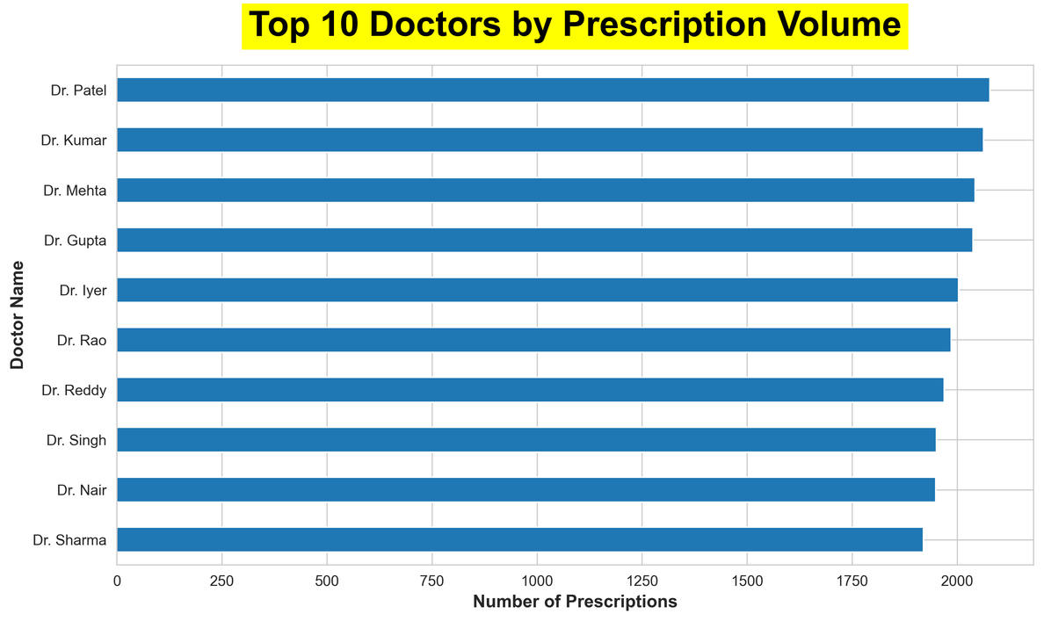
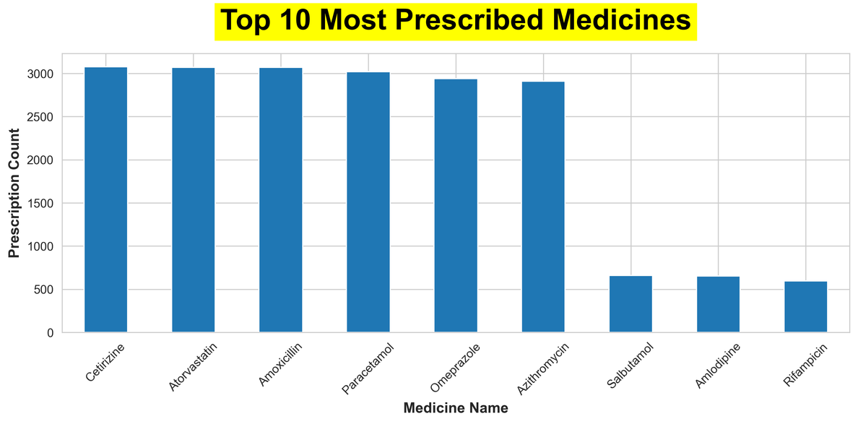
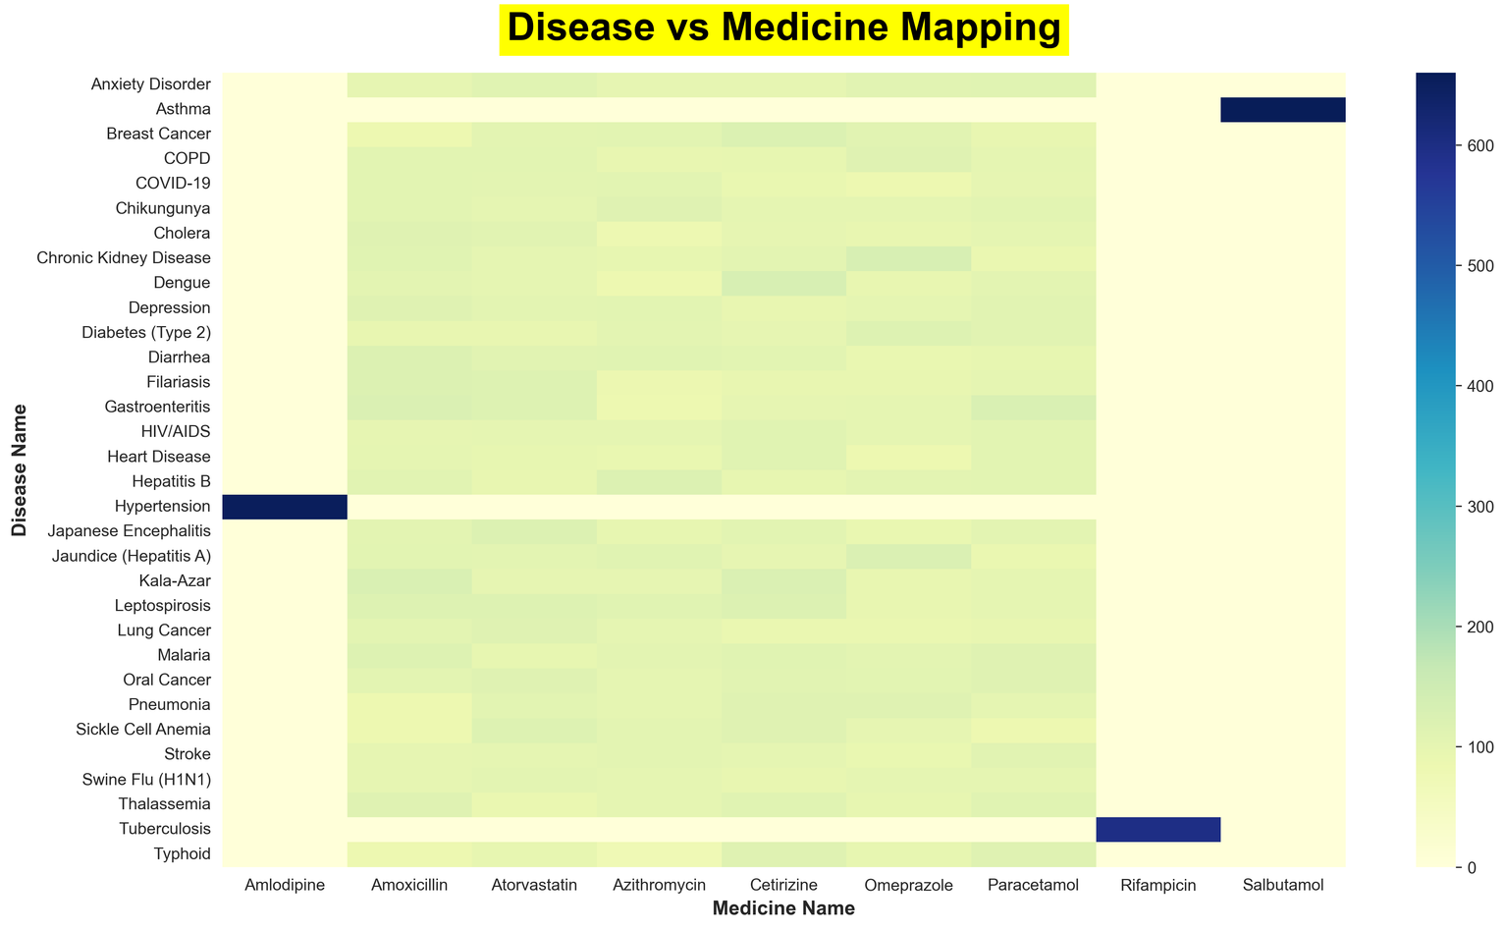
Data Visualization

Slide 9
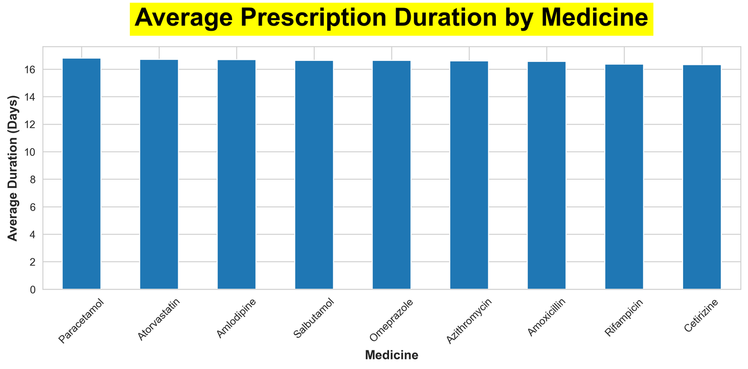
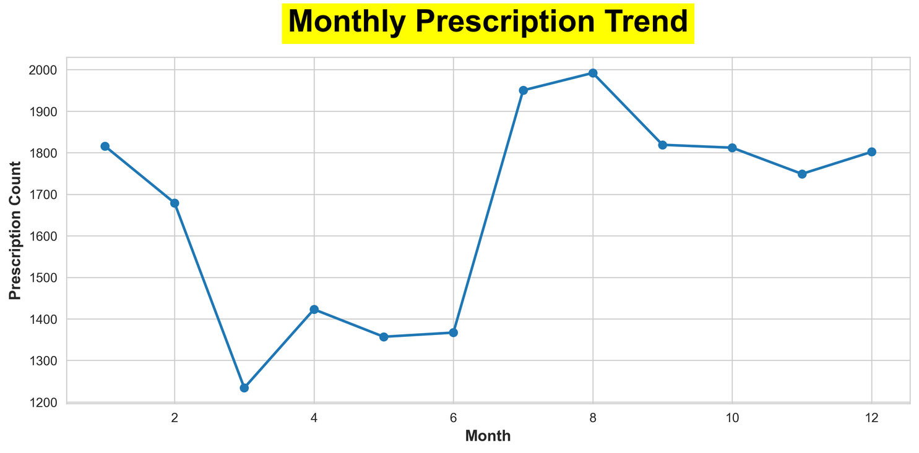

Slide 10
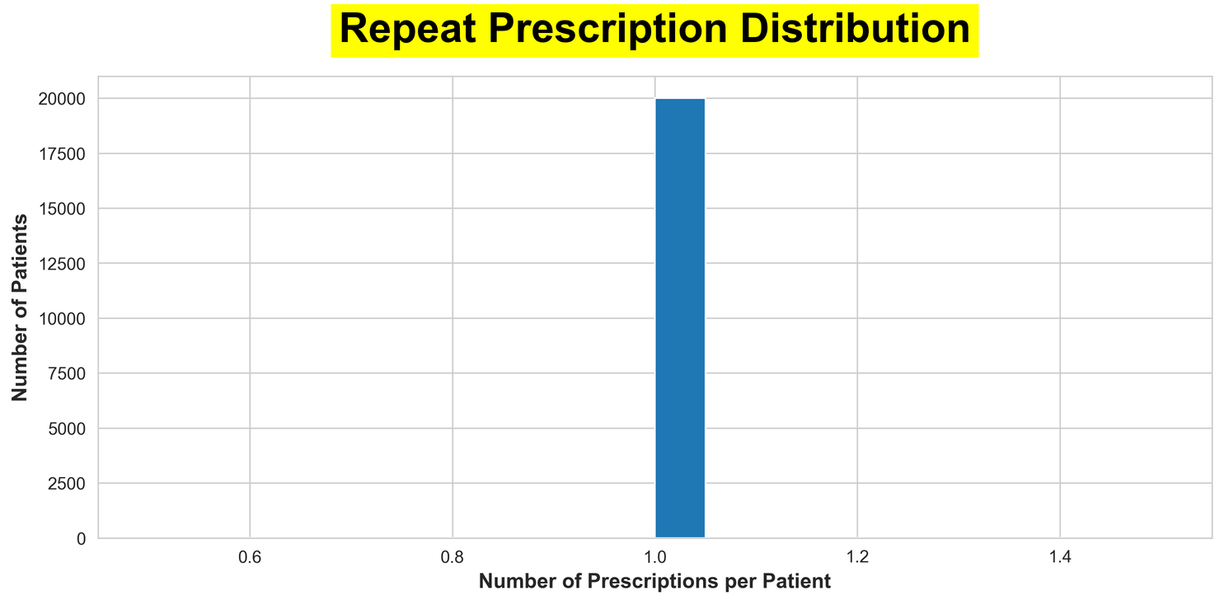
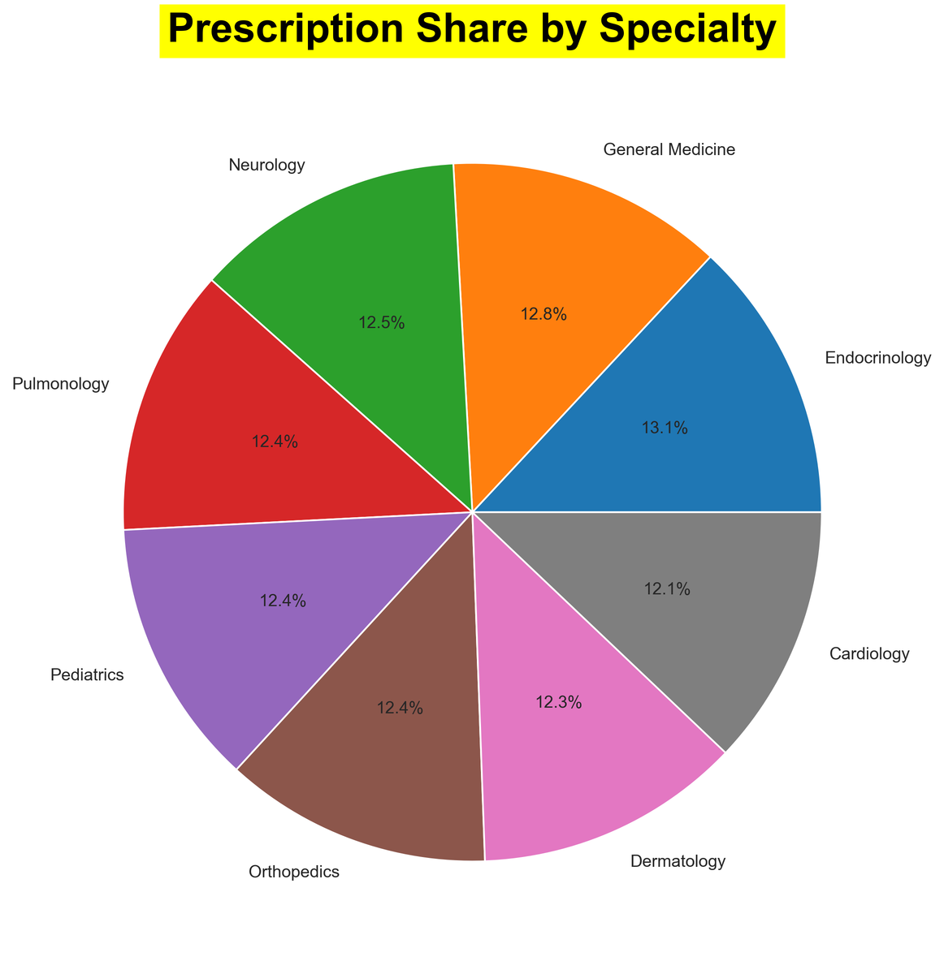

Slide 11
Key Findings
01
Prescription volume was evenly distributed among top doctors.
02
Endocrinology recorded the highest prescription share among specialties.
03
Hypertension, Asthma, and Tuberculosis shows strong medicine-specific treatment patterns.
04
Average prescription duration remained consistent at around 16–17 days.
05
Key medicines showed high prescription demand.

Slide 12
Conclusion
This project successfully analyzes healthcare prescription data to identify important patterns related to patients, doctors, diseases, and medicines. By using Python, Pandas, and MySQL, the raw data is cleaned, stored, and processed to generate meaningful insights.
The visualizations and analysis help in understanding prescription trends, doctor performance, and patient revisit behavior. The CLI-based system makes it easy to interact with the data and retrieve results efficiently.
Overall, this project demonstrates how data analytics can be effectively used in healthcare to support better decision-making and improve system efficiency.

Slide 13
Thank
You

